Slide 1
Predicting Problematic Internet Use
Notes:
The goal of our project is to

Slide 2
The problem
“Can you predict the level of problematic internet usage exhibited by children and adolescents, based on their physical activity?”
Kaggle Competition, sponsored by the Child-Mind Institute.
Notes:
CLICK
Researchers have identified internet use as having the potential to rise to the level of addiction, and problematic internet is associated with increased rates of anxiety and depression. For these reasons, being able to identify problematic internet use is a worthwhile goal. However, under current circumstances, identifying problematic internet usage requires evaluation by an expert, for example, a psychologist. This significantly limits the ability to evaluate all children and adolescents. If it could be effectively predicted based on physical activity, prediction could potentially be done by, say, a family physician.
CLICK
This project came to us by way of a current Kaggle competition; Kaggle is a data science competition platform. This particular competition was sponsored by the Child-Mind Institute. The Child-Mind Institute is focused on mental health and learning disabilities among children and adolescents, supporting research, clinical work, and educational outreach.

Slide 3
The data
Target variable: Severity Impairment Index (SII)
Ordinal: Values 0 (“None”) to 3 (“Severe”)
Based on Parent-Child Internet Addiction (PCIAT) score, from 20 question survey
Predictor variables (33 variables)
Demographics: age and sex
Internet Use: hours of using computer/internet per day.
Children's Global Assessment Scale: rating the general functioning of youth, as measured by clinicians
Physical Measures: blood pressure, heart rate, height, weight and waist, and hip measurements.
Fitness test results: includes measures of aerobic capacity, muscular strength, muscular endurance, flexibility, and body composition.
Bio-electric Impedance Analysis: measures of key body composition elements, including BMI, fat, muscle, and water content.
Physical Activity Questionnaire: Information about children’s physical activity over the last 7 days.
Sleep Disturbance Scale: Scale to categorize sleep disorders in children.
Accelerometer data: continuous recording of accelerometer data for a single subject spanning many days.
~3960 participants
~3000 with at least some target information.
Notes:
The data for the competition comes from a research study conducted by the Child-Mind Institute. (CLICK) The target variable is the severity impairment index, or sii. (CLICK) This is an ordinal variable, values ranging from 0, or no impairment, to 3, or severe impairment. (CLICK) The sii score is derived from scores on a 20-question survey completed by participants and their families. We had access to individual survey question responses as well.
(CLICK) We were given a total of 33 predictor variable, spanning a variety of physical measurements. The variables naturally fall into several groupings. This includes (CLICK) demographics, (CLICK) hours of internet use, (CLICK) a clinical assessment of general functioning, (CLICK) physical measurements that one might take as part of a check-up, (CLICK) results from a fitness test similar to the Presidential Fitness Test that some of you may have completed in high school, (CLICK) measures from a bio-electric impedance analysis, (CLICK) a score from a physical activity questionnaire, (CLICK) and an evaluation of sleep disturbance. (CLICK) We also had accelerometer data: some of the participants wore an accelerometer wristwatch for roughly one month; and we had accelerometer data on 5-second intervals for those participants.
(CLICK) At least some data was provided for approximately 3800 participants, although as we’ll discuss later, a large number of participants had to be eliminated because of missing data.

Slide 4
Data Challenges
Constraints of Contest
No team members with substantial domain knowledge
No contact with “primary client” (Child-Mind Institute)
Accelerometer data
Time series data->Need to convert to one or more summary variables measuring activity
Data provided is 5-second averages->standard summary variables were not applicable.
Other data issues
Missing data
Inconsistencies in the data
Notes:
We wanted to start by discussing some of the more interesting challenges we faced in our initial work on the data, before we got to the business of constructing and evaluating models.
(CLICK) (SKIP THIS SECTION?) We opted to work on the Kaggle competition project because we were interested in the topic, but also because we also thought the competition set-up might provide a more streamlined scenario to work in. But we also found the competition set-up brought up its own issues. (CLICK) In particular, the data set was predetermined, so we had no control of what the data was and none of the team members had any expertise relevant to the dataset. Also, we had no contact with the primary client, the Child-Mind Institute, to discuss the data or research question in any way. Although these are not problems unique to a competition setting, the setting may have exacerbated them.
(CLICK) One aspect of the data that we initially found very intriguing and promising was the accelerometer data, collected over roughly 1 month from about 1000 of the participants. (CLICK) The data provided was time-series data. To make it useful, we needed to develop one of more variables that would summarize activity for each participants. (CLICK) One limitation we faced was that were weren’t provided the raw accelerometer data, but rather 5-second running averages. Although there are some standardized ways of doing this, these methods weren’t directly applicable to the form out data took. We ultimately developed two custom variables based on a literature review.
(CLICK)
There was also considerable missing data. Almost 1000 participants did not complete any of the Parent-Child Internet Addiction Survey, so there was no information on the target variable; these cases were dropped. Other participants did not answer some of the survey questions, leading to potential inaccuracies in the SII score. Among the 3000 cases with SII scores, every case was missing data for at least one variable.
There were some other issues with the data itself. (SAY SOMETHING here about grip strength? The way they computed SII score?)

Slide 5
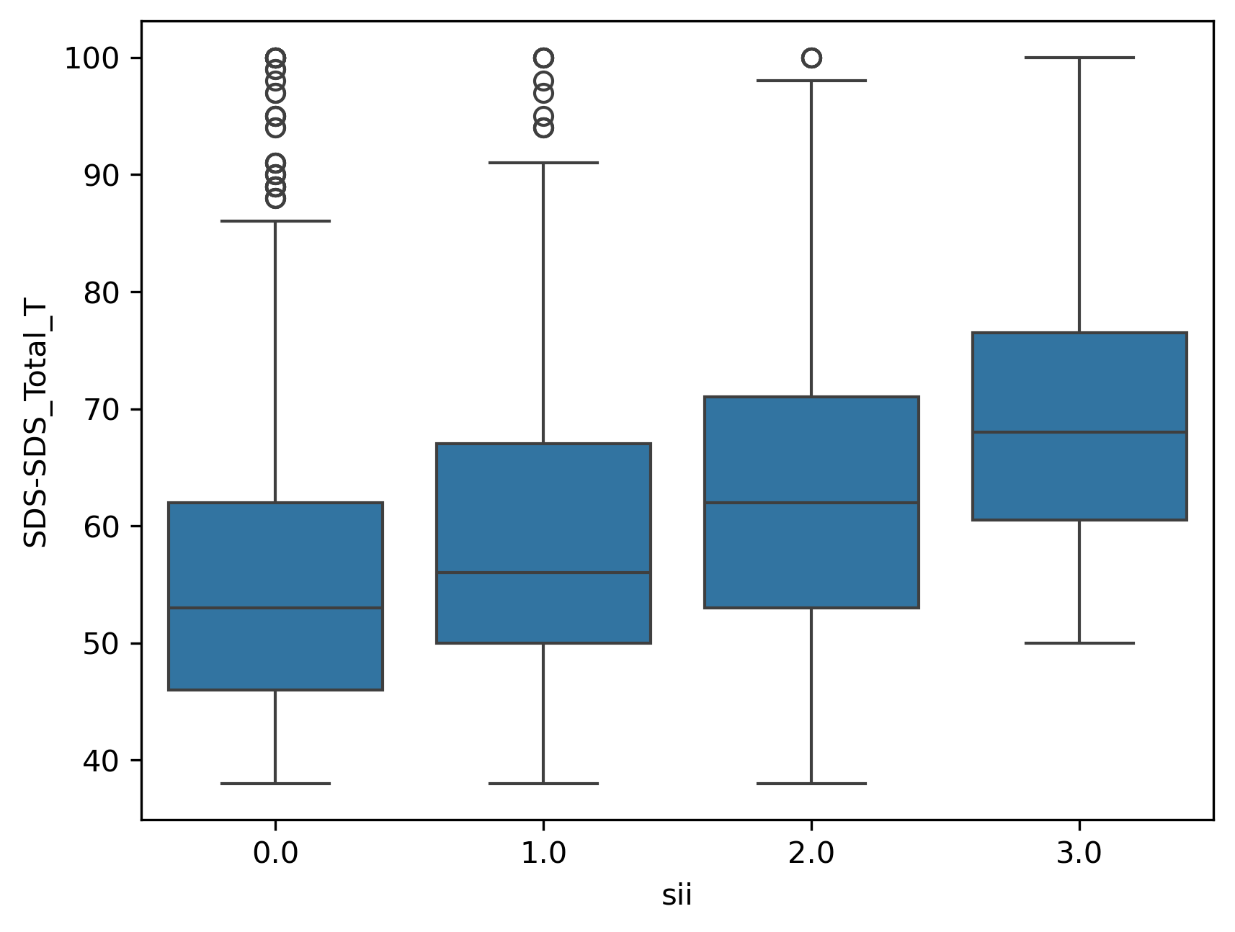
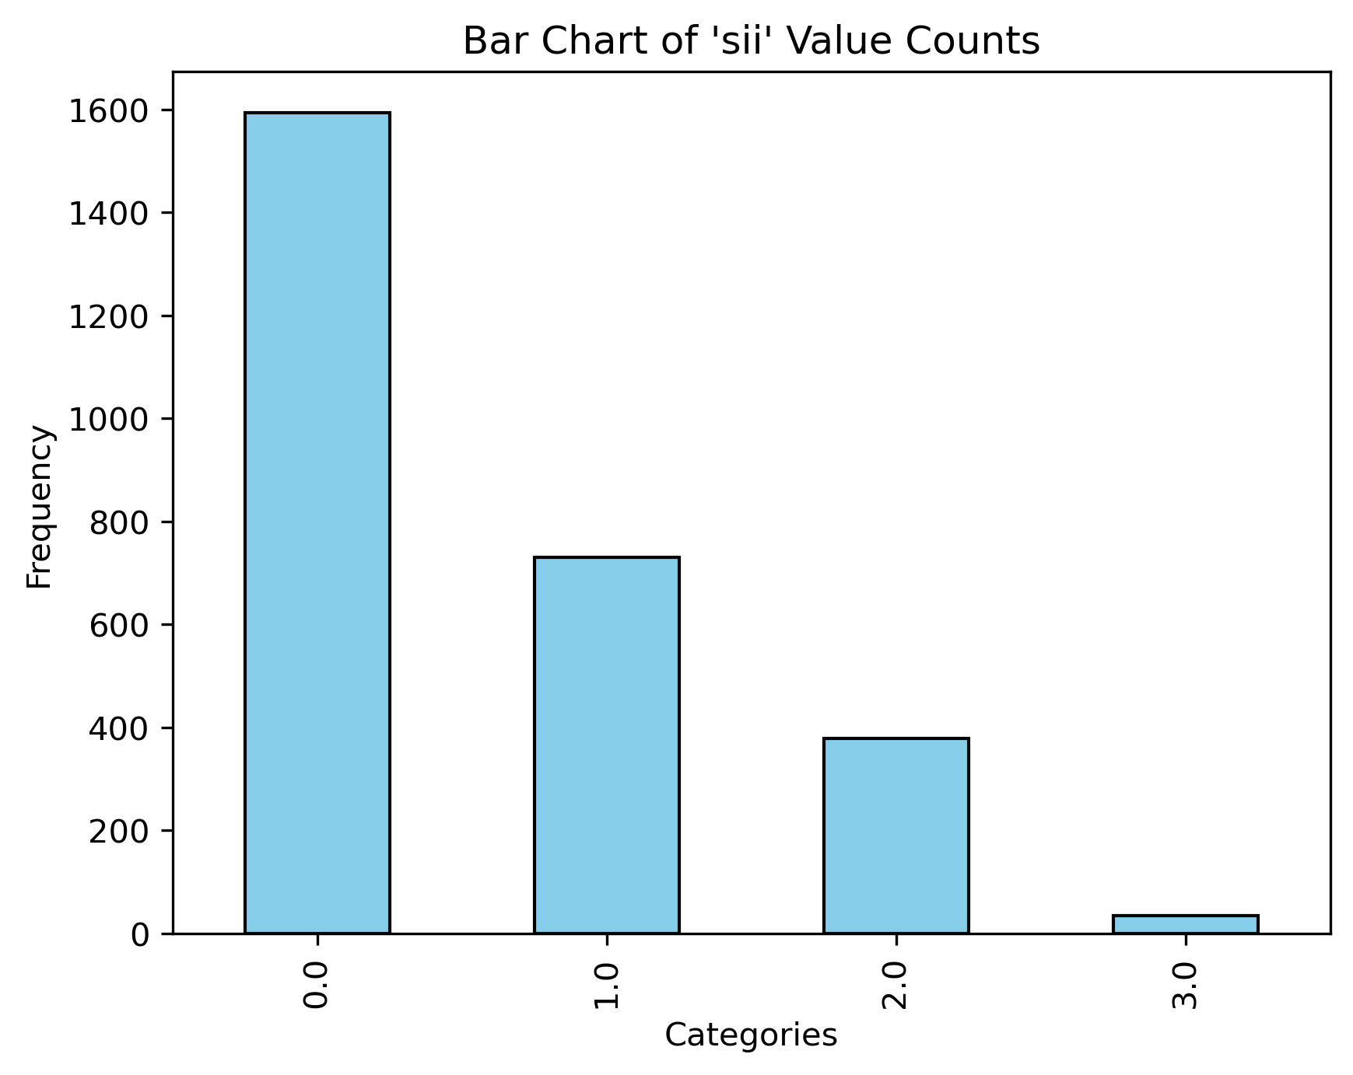
Data Challenges
No predictor variables showed much predictive power.
Sparse data for SII score 3.
Notes:
The previous issues I mentioned were more situational, but there were also some important challenges intrinsic to the data itself.
(CLICK)
In our exploratory data analysis, we saw no strong relationships between any of the predictor variables and SII, suggesting that it may simply be difficult to predict problematic internet usage based on physical activity.
(CLICK)
Additionally, the distribution of participants across SII scores was very uneven. In particular, there were only XX participants who were measured with an SII score of 3, or severe, in the entire data set; and a very high rate of 0’s. Because of this, our models generally had a very hard time predicting 3’s.

Slide 6
Modeling Process
Contest-specified evaluation: Cohen’s Kappa with quadratic weights
Measure of accuracy for ordinal variables
Imputation of missing values
KNN imputation of missing PCIAT question responses, for improved PCIAT total score/SII score.
Custom imputation for predictor variables:
Performance comparison of KNN vs. MICE
follow-up encoding of derived “zone” variables.
Duplicate data to inflate # of SII 3’s.
Multiple options for prediction
Predict SII directly, as quantitative variable
Predict PCIAT and compute SII
Option to tweak SII bin cut-offs.
Ordinal classifier for SII
Notes:
Some of these issues we attempted to address prior to modeling and some as part of the modeling process. Here we wanted to share some of the interesting aspects of our modeling work.
(CLICK) The competition evaluates submissions using Cohen’s Kappa, (CLICK) which is a measure of accuracy for ordinal variables. We couldn’t directly incorporate this into our model training as the loss function, but we did use this to compare models.
(CLICK) Because there was so much missing data, we needed to use imputation, rather than just remove cases with missing values.
(CLICK) Recall that the PCIAT questionnaire is the basis for the SII score, our ultimate target variable. We eliminated all cases that had no PCIAT data, and then imputed any remaining missing data for individual PCIAT questions. All questions were scored on the same scale, so we used KNN imputation here.
(CLICK) For the predictor variables, we tested both KNN and a MICE imputation. Some of the variables, various fitness zones, were derived from the fitness test quantitative measurements. Rather than imputing the zone values, we computed these separately after running the imputation.
(CLICK) To address the low number of severe, or 3 values, for the target variable SII, we also tested models where we duplicated cases with SII scores of 3 in our training data, and we ultimately found that this increased the effectiveness of our models.
(CLICK) Lastly, we had a choice of exactly what we would use as our target variable. Recall that SII is an ordinal variable, derived from the PCIAT score, a quantitative variable. (CLICK) One option would be to predict SII directly, treating it as essentially a quantitative variable. (CLICK) Another option was to predict PCIAT scores and then compute SII based on it. In this scenario, we found that our models seemed to underpredict SII. In fact, we could not build a model that would predict any 3’s, the highest SII score. To try to address this, we also played with different cut points for translating PCIAT score to SII. (CLICK) The last option we saw was to try to predict SII using classification. However, we didn’t want to lose the fact that SII is an ordinal variable. So rather than using straight classification, we identified some strategies for an ordinal classifier.

Slide 7
Final Results
Say something here about the models that rose to the top and the performance of those models.

